Slide 1
Pose Classification Using Alexnet's Convolutional Neural Network Model
2072025 Sherly Santiadi
2072051 Nisa Deviani Agustin Ruis

Slide 2
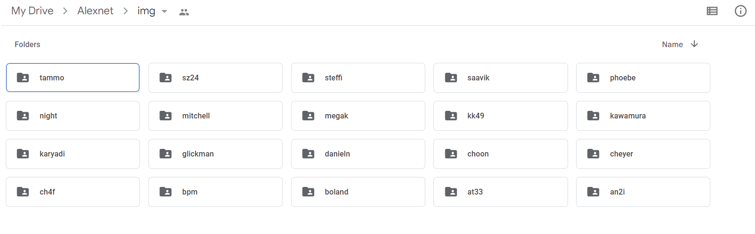
Problem: Face Recognition
Many target functions can be learned from the image data
Direction which the person is facing: left, right, straight, upward
Expression the person is showing: neutral, happy, sad, angry
Whether or not wearing sunglasses
Image Dataset
1.506 grayscale images: 20 different people: approx 72 images per person

Slide 3
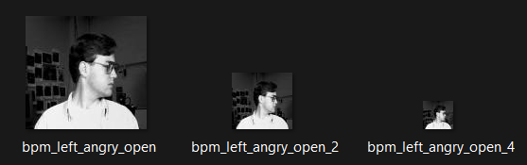
Data Format
bpm_left_angry_open_2 : <userid>_<pose>_<expression>_<eyes>_<scale>.pgm
None indicates a full-resolution image (128 columns by 120 rows)
2 indicates a half-resolution image (64 by 60)
4 indicates a quarter-resolution image (32 by 30)

Slide 4
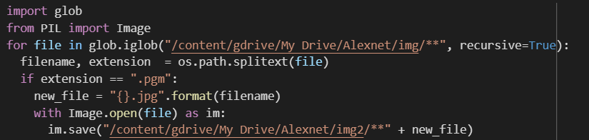
Convert Image Extension (.pgm into .jpg)
Before we feed the images into our model, we need to convert the image extension from .pgm into .jpg.
In this section, we use Python Library (Pillow) to convert multiple images into .jpg format.
We need to import glob module to find all the path names matching a specified pattern. Then, we save converted images into new directory (from dir ‘img’ into ‘img2’).

Slide 5
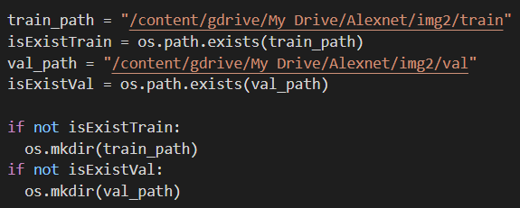
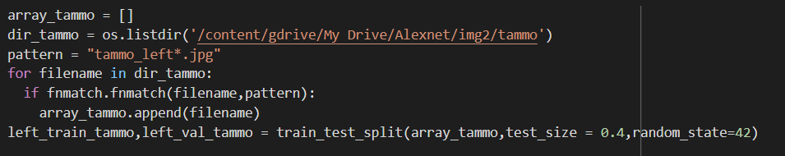
Splitting a Dataset
Before we split the dataset, we need to check whether the directory exists or not. If the directory doesn't exist hence we’ll create a new directory in the specified path. We split into means that approximately 40 percent of samples will be assigned to the test data, and the remaining 60 percent will be assigned to the training data.

Slide 6
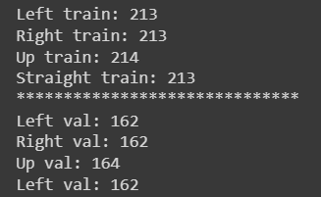
Train and Test Set
1506 * 60% = approx 903 images into train set (213+213+214+213 = 853)
1506 * 40% = approx 602 images into test set (162+162+164+162 = 650)

Slide 7
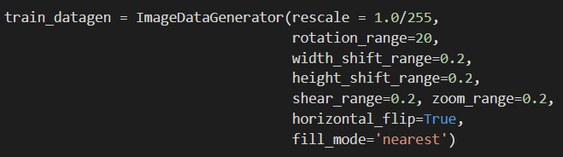
Preprocessing
Rescale = 1.0/255 will convert the pixels in range [0,255] to range [0,1].
Rotation_range = 20 will random rotate images with random angles between -20 degree and 20 degree.
Width/height_shift_range = 0.2 means it will shift image randomly between -20px to +20px.
Shear_range=0.2 means shear the image by 20%. Zoom range = 0.2 means zoom in & zoom out by 20%.
Horizontal_flip = True means to "flip" or "mirror" an image in the horizontal direction (left-right).
Fill_mode = nearest means simply replaces the empty area with the nearest pixel.

Slide 8
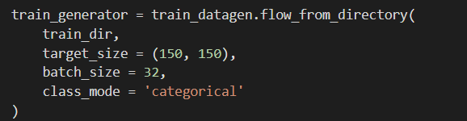
Preprocessing
Flow from : train_dir
Target size (input size): 150*150
If unspecified, batch_size will default to 32. Do not specify the batch_size if your data is in the form of datasets, generators, or keras.utils.Sequence instances (since they generate batches).
Class_mode = ‘categorical’ : 2D output (aka. list of numbers of length N), [0, 0, 1, 0], which is a one-hot encoding (only one number is 1/ "hot") representing the donkey.

Slide 9
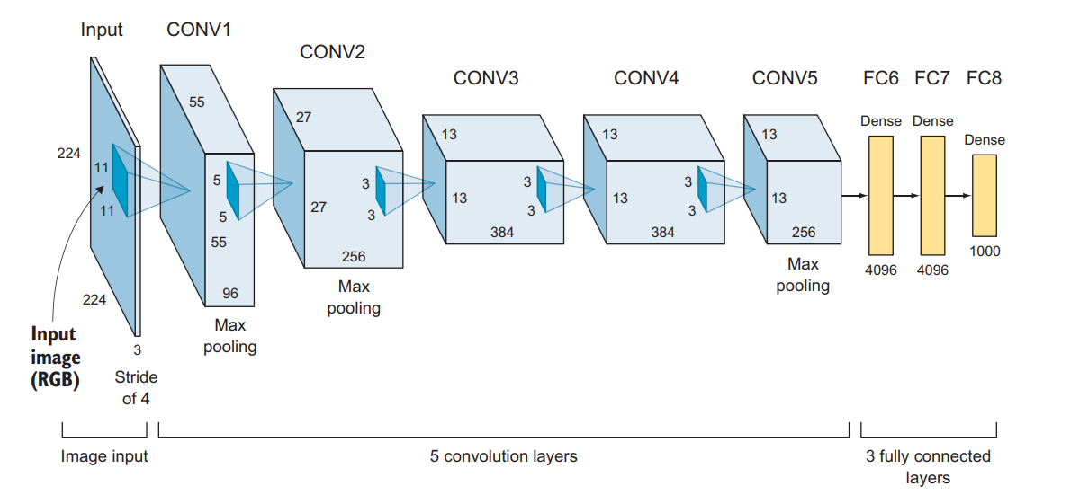
Model

Slide 10
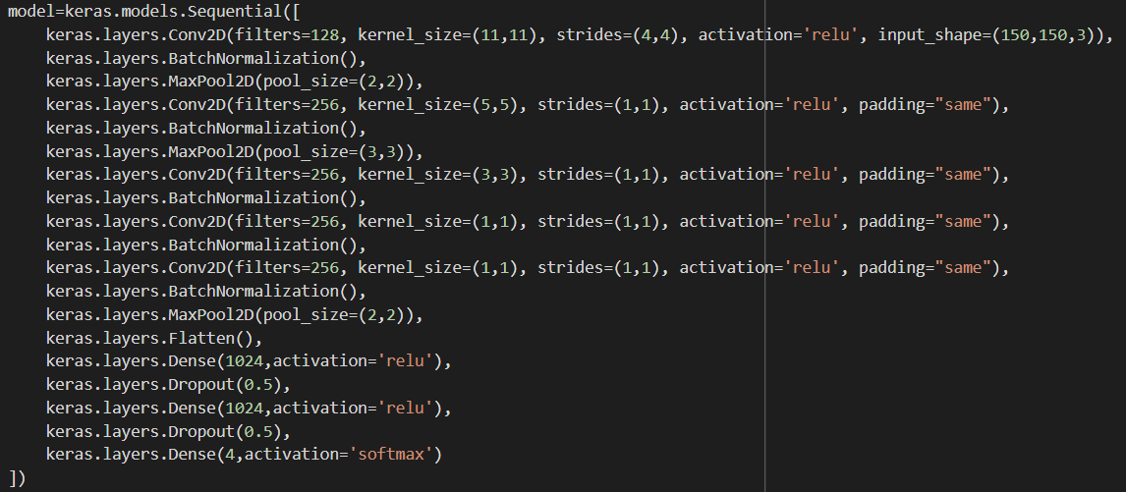
Model

Slide 11
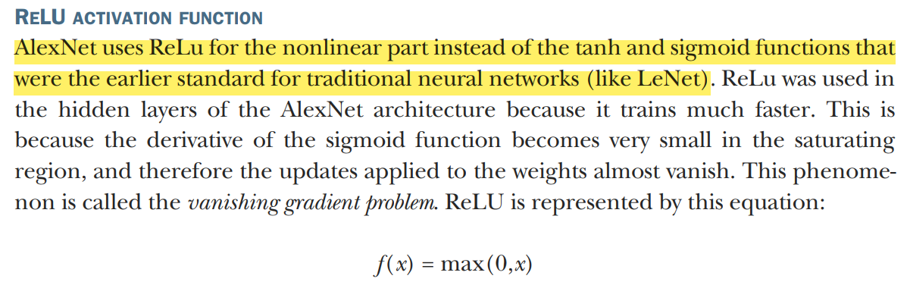
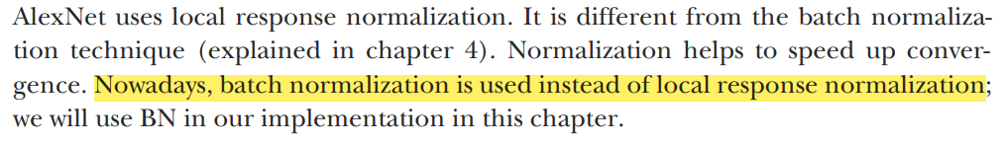
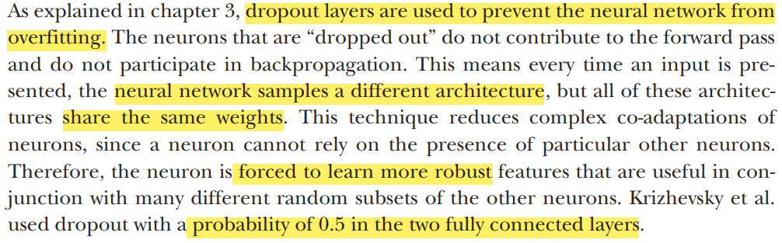
Activation Function (ReLu)
Batch Normalization
Dropout Layer

Slide 12
Model
Fitting the Model
Categorical crossentropy is a loss function that is used in multi-class classification tasks.
Adaptive Moment Estimation is an algorithm for optimization technique for gradient descent with learning rate = 0.001.
Evaluating classification model using accuracy metrics.
Steps_per_epoch = 25 (this is used one batch size of training data to train the model)
Epoch = 100
validation_steps = single backpropagation performed on the validation data (to track validation accuracy)
verbose=2 will just mention the number of epoch

Slide 13
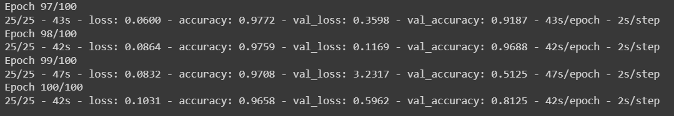
Accuracy

